Slide 1
Data-Driven Sports Score Forecasting
Team Members
71762131055 - Sweha S

Slide 2
Problem Statement
In the game of cricket, accurately predicting the final score of a team is essential for strategic planning and decision-making during a match.
Various factors such as the number of overs played, total runs scored, wickets fallen, and recent performance in the last few overs significantly influence the final score prediction.
This project aims to develop a predictive model that can forecast the final score of a cricket team based on real-time match statistics. By leveraging historical data and machine learning techniques, the goal is to provide teams with valuable insights to adapt their strategies dynamically during the game.

Slide 3
Objectives
The objective of predicting cricket team scores is to develop a robust machine learning model capable of accurately forecasting the final score of a cricket match based on real-time match statistics. This predictive model serves the following technical purposes:
Algorithm Optimization
Feature Engineering
Model Training
Evaluation

Slide 4
Expected Outcome
The technical outcome of predicting cricket team scores involves developing a robust machine learning model that accurately forecasts the final score of a cricket match based on real-time match statistics.
This model is expected to demonstrate high predictive accuracy, as evidenced by low error metrics such as Mean Absolute Error (MAE), Mean Squared Error (MSE), and Root Mean Squared Error (RMSE) during evaluation.
Additionally, the model's performance should be consistent across different match scenarios and datasets, indicating its reliability and generalization capabilities.
Real-time deployment of the model enables seamless integration into live match environments, providing stakeholders with timely insights for strategic decision-making.
Continuous monitoring and refinement of the model ensure its adaptability to evolving match dynamics and improve prediction accuracy over time. The technical outcome ultimately delivers a sophisticated predictive tool that enhances decision-making, strategic planning, and performance assessment in the realm of cricket matches.

Slide 5
Dataset
Dataset Name: data.csv
It contains several attributes such as Match Id, Batting team name, Bowling team name , date, Venue, Batsman, Bowler, runs, runs, wickets, overs , runs scored in last 5 overs, wickets taken in last 5 overs, striker, non-striker and total.
80% of dataset used for training and 20% of data used for testing.

Slide 6
Algorithm Used
Linear Regression
Linear Regression
Neural Network
Finally we select the best model from the above algorithms by comparing their Root Mean Squared Error value.

Slide 7
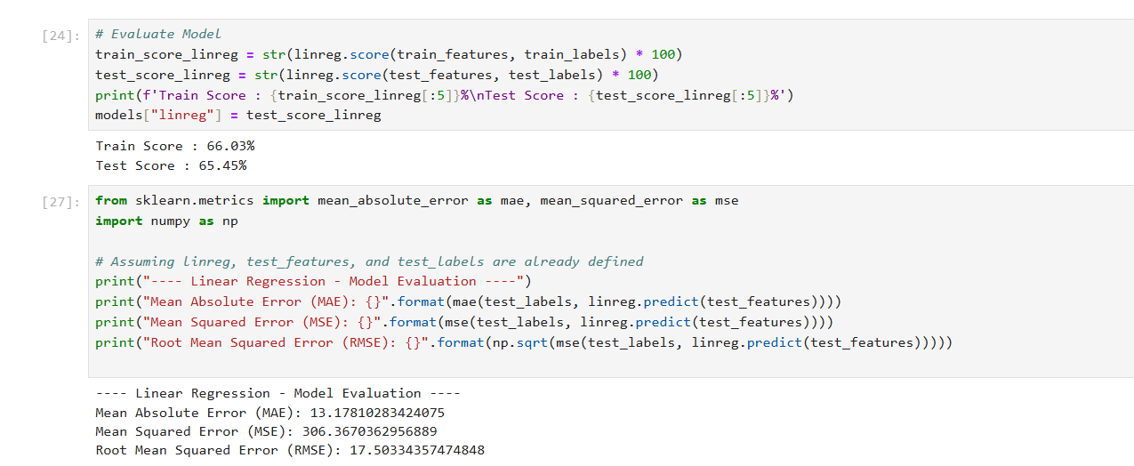
Linear Regression

Slide 8
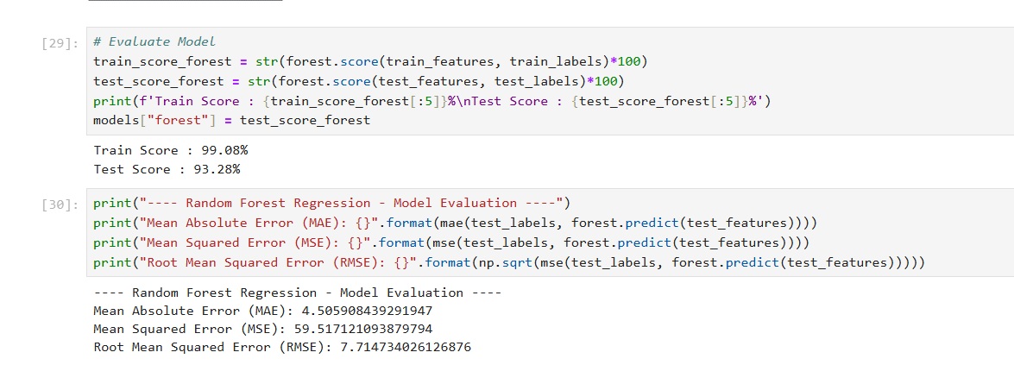
Random Forest

Slide 9
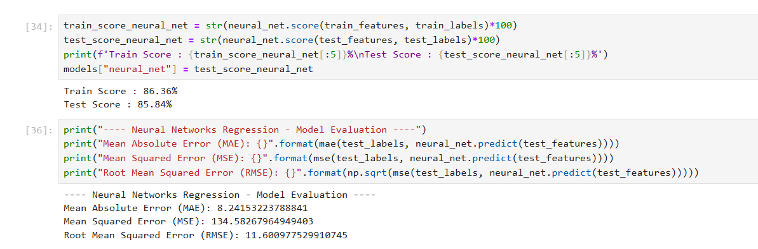
Neural Network

Slide 10
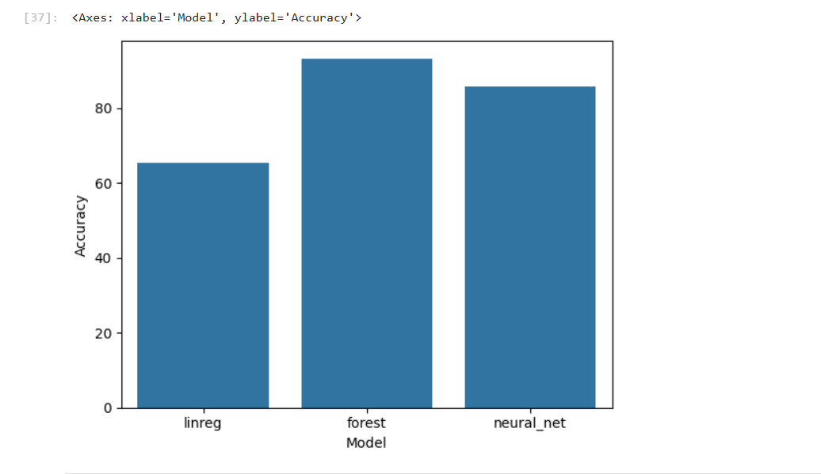
Best Model

Slide 11
Thank You

